Slide 1

VIEW AND LAYOUT

Slide 2





LAYOUT / VIEW GROUP
OTHER COMPONENT
STYLE
THEME

Slide 3
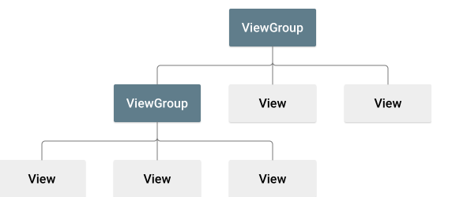
LAYOUT
A layout defines the structure for a user interface in your app
All elements in the layout are built using a hierarchy of View and ViewGroup

Slide 4
LAYOUT
A View usually draws something the user can see and interact with
ViewGroup is an invisible container that defines the layout structure for View and other ViewGroup objects

Slide 5
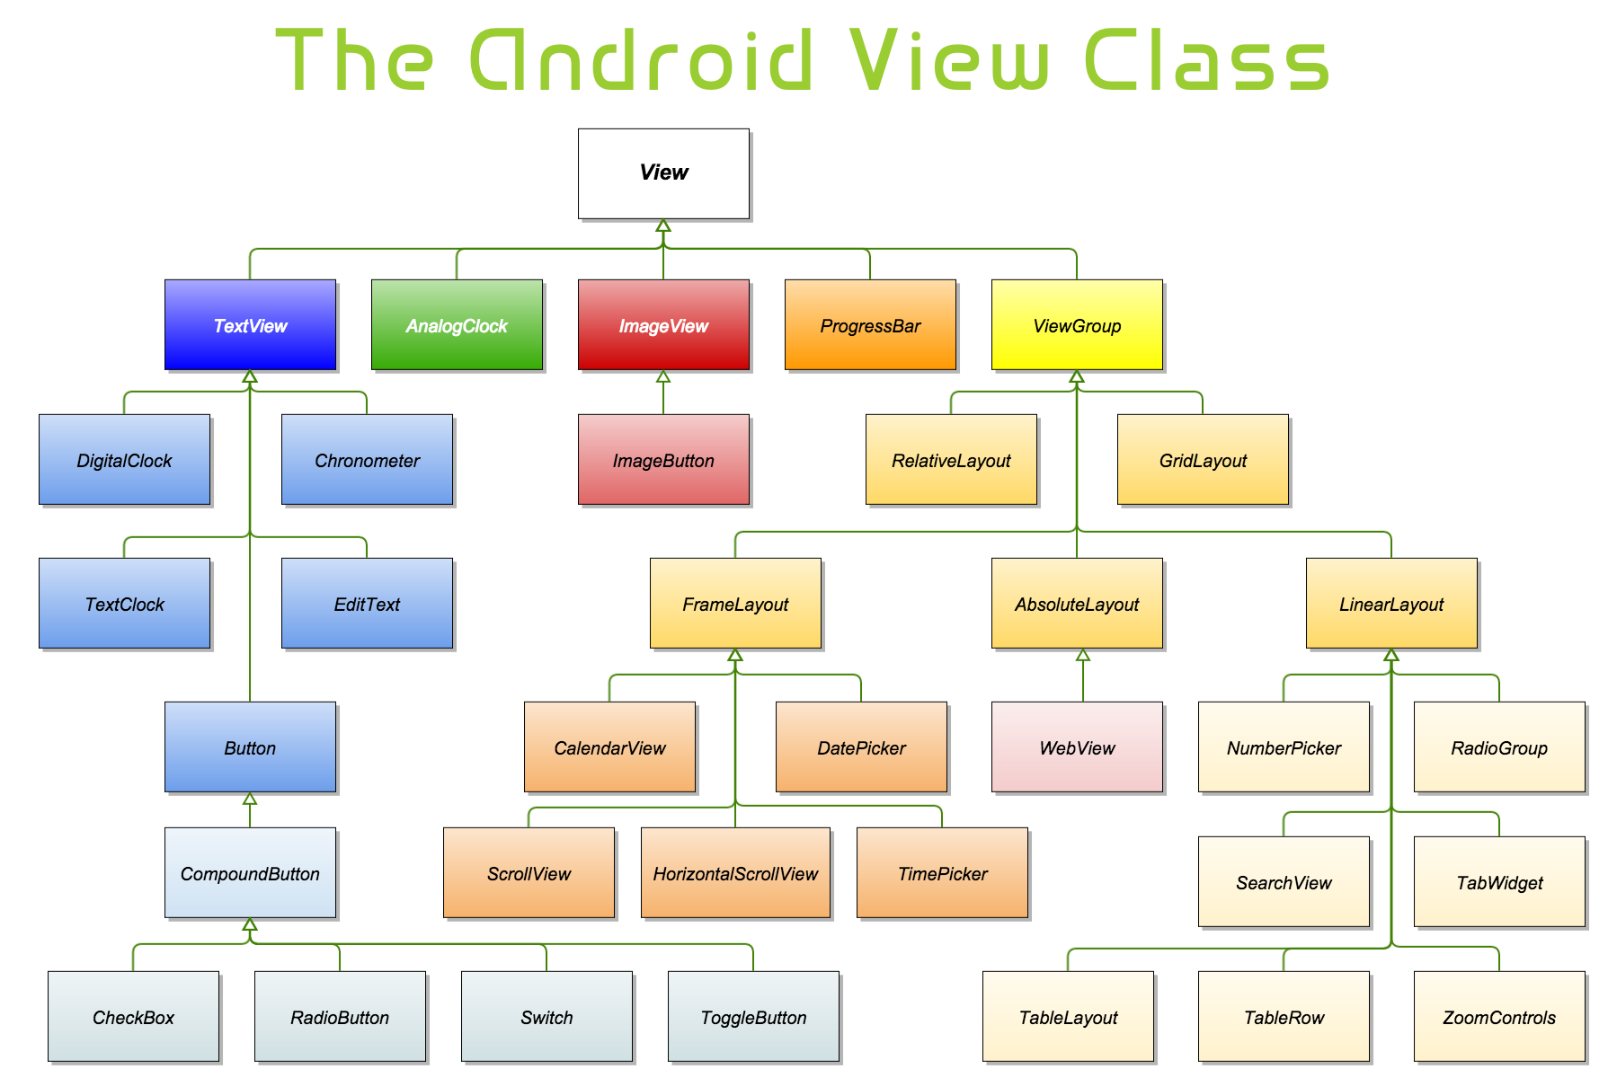
LAYOUT

Slide 6
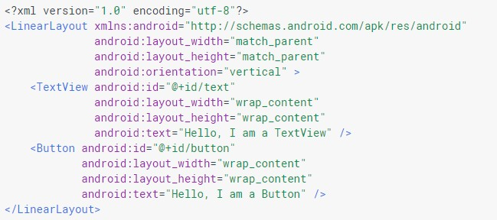
DECLARE LAYOUT
Declare UI elements in XML

Slide 7

DECLARE LAYOUT
When you compile your app, each XML layout file is compiled into a View resource
Load the layout resource from your app code, in your Activity.onCreate()
Do so by calling setContentView(), passing it the reference to your layout resource in the form of

Slide 8
LAYOUT
Layout or any component should have unique id
Some layout attribute
wrap_content
match_parent
size
padding
margin

Slide 9
Commonly Used Attributes
Size
android: layout_height, android:layout_width
match_parent: fill the parent space (minus padding)
wrap content: use natural size (plus padding)
An explicit size with a number and a dimension. See margins on next slide.
android:layout_weight
A number that gives proportional sizes. See example.

Slide 10
Commonly Used Attributes
Alignment
android: layout_gravity
How the View is aligned within containing View.
android: gravity
How the text or components inside the View are aligned.
Possible values
top, bottom, left, right, center_vertical, center_horizontal, center (i.e., center both ways), fill_vertical, fill_horizontal, fill (i.e., fill both directions), clip_vertical, clip_horizontal

Slide 11
Commonly Used Attributes
Margins (blank space outside)
android:layout_marginBottom, android:layout_marginTop, android:layout_marginLeft, android:layout_marginRightandroid:layout marginRight
Padding (blank space inside)
android:paddingBottom, android:paddingTop, android:paddingLeft, android:paddingRight
Units (e.g., "14.5dp")
dp: density-independent pixels (scaled by device resol.)
sp: scaled pixels (scaledbased on preferred font size)
px: pixels
in: inches
mm: millimeters

Slide 12
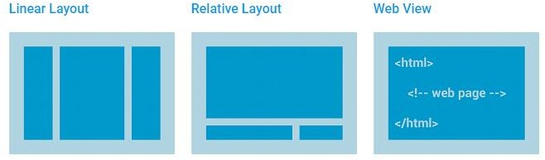
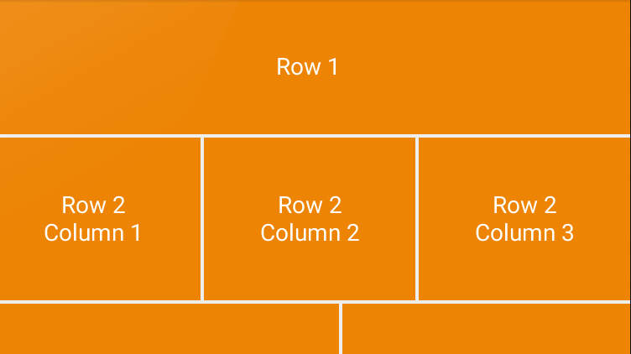
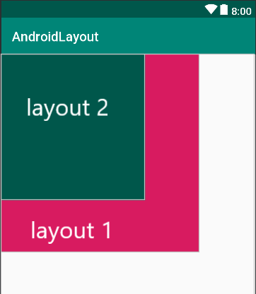
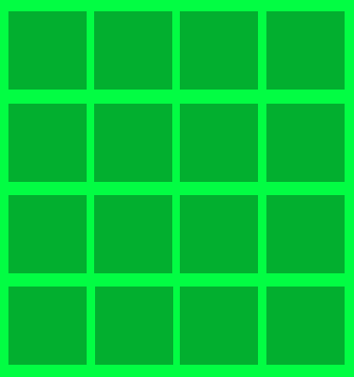
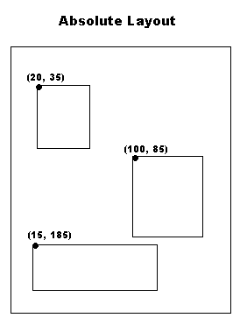
TYPE OF LAYOUT
Linear Layout Relative Layout Table Layout
Frame Layout Grid Layout Absolute Layout

Slide 13
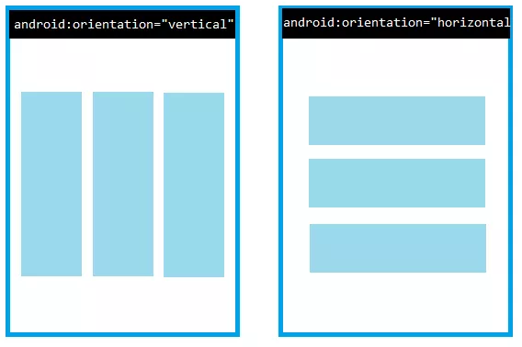
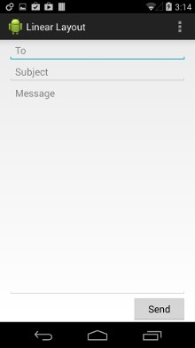
LINEARLAYOUT
Lay out children in a single row or column (depending on if its android:
orientation is horizontal or vertical).

Slide 14
LINEARLAYOUT
<LinearLayout xmlns:android="http://schemas.android.com/apk/res/android" android:layout_width="match_parent" android:layout_height="match_parent"
android:orientation="vertical" >
<EditText android:layout_width="match_parent" android:layout_height="wrap_content"
<EditText android:layout_width="match_parent" android:layout_height="wrap_content"
<EditText android:layout_width="match_parent" android:layout_height="0dp" android:layout_weight="1" android:gravity="top"
<Button
android:layout_width="100dp" android:layout_height="wrap_content" android:layout_gravity="right"
</LinearLayout>

Slide 15
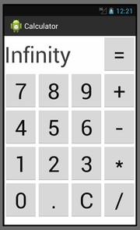
GRIDLAYOUT
Child views can be added to a GridLayout by declaring the elements within the
<GridLayout> structure in the XML file. If no row and column values are declared for a child it is positioned automatically by the GridLayout class based on the configuration of the layout and the position of the view in the XML

Slide 16
GRIDLAYOUT
<GridLayout xmlns:android="http://schemas.android.com/apk/res/android"
xmlns:tools="http://schemas.android.com/tools" android:id="@+id/GridLayout1" android:layout_width="wrap_content" android:layout_height="wrap_content" android:columnCount="2" android:rowCount="2" android:orientation="horizontal" tools:context=".GridXMLActivity" >
<Button
android:id="@+id/button1" android:layout_gravity="left|top" android:text="Button" />
<Button
android:id="@+id/button2" android:layout_gravity="left|top" android:text="Button" />
</GridLayout>

Slide 17
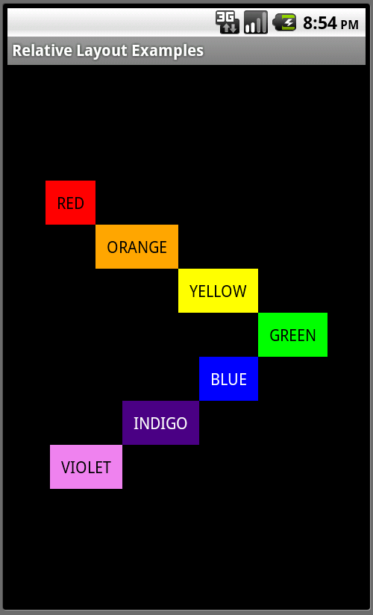
RELATIVELAYOUT
RelativeLayout lets child views specify their position relative to the parent view or to each other (specified by ID)

Slide 18
RELATIVELAYOUT
Some of the many layout properties available to views in a RelativeLayout include:
android:layout_alignParentTop
If "true", makes the top edge of this view match
the top edge of the parent.
android:layout_centerVertical
If "true", centers this child vertically within its parent.
android:layout_below
Positions the top edge of this view below the view specified with a resource ID.
android:layout_toRightOf
Positions the left edge of this view to the right of the view specified with a resource ID.

Slide 19
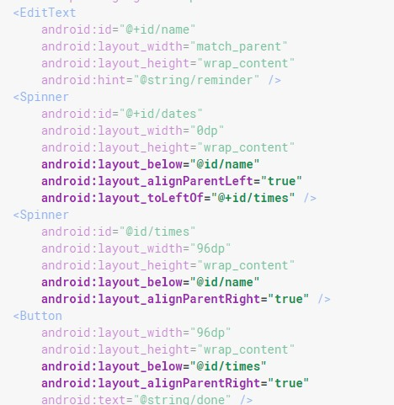
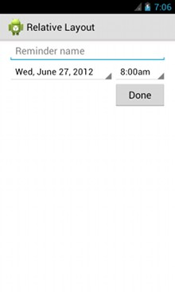
RELATIVELAYOUT

Slide 20
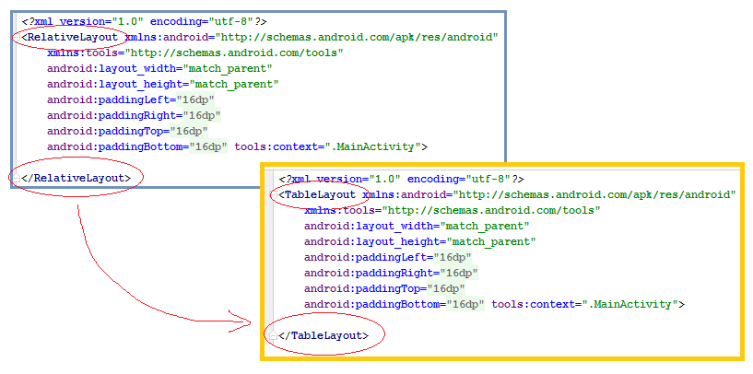
TABLE LAYOUT

Slide 21
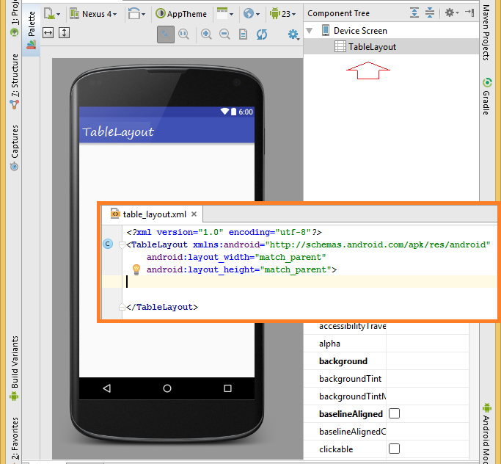
TABLE LAYOUT

Slide 22
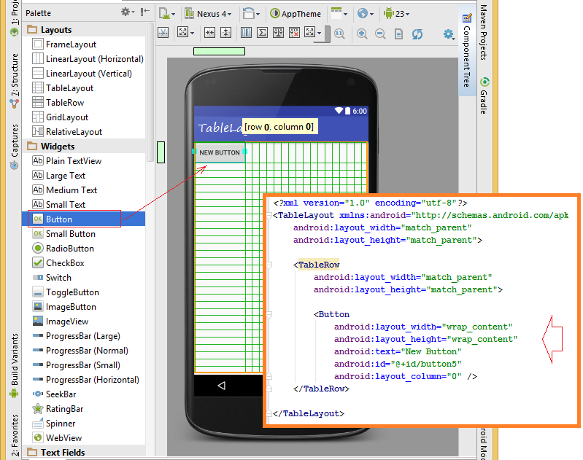
TABLE LAYOUT

Slide 23
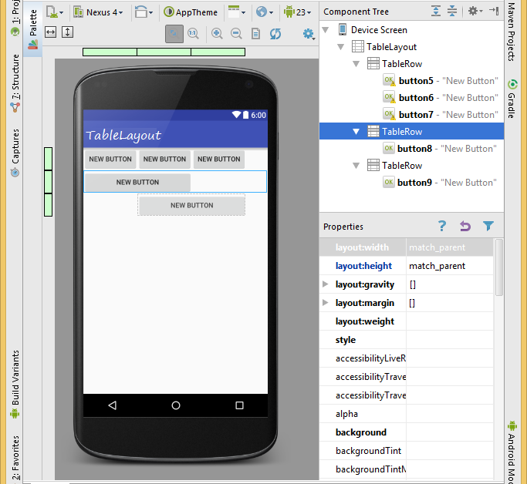
TABLE LAYOUT

Slide 24
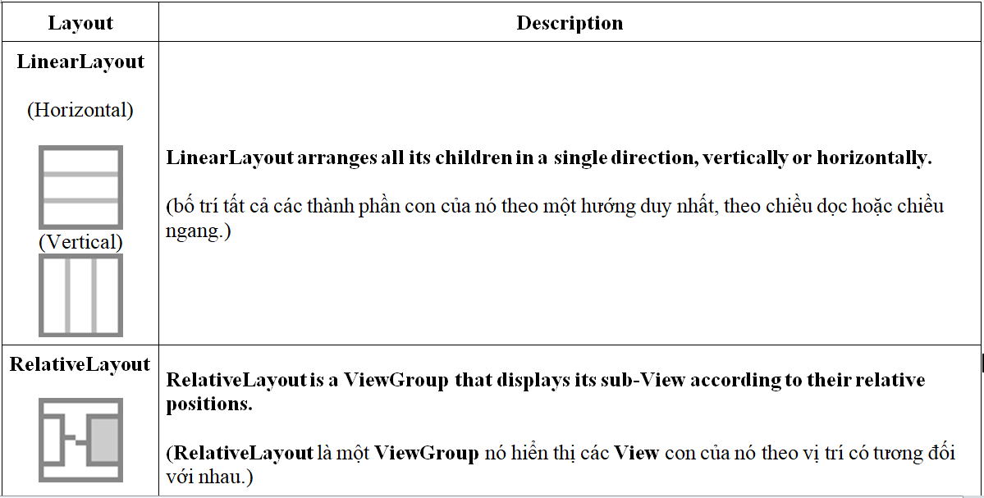
CONCLUTIONS LAYOUT

Slide 25
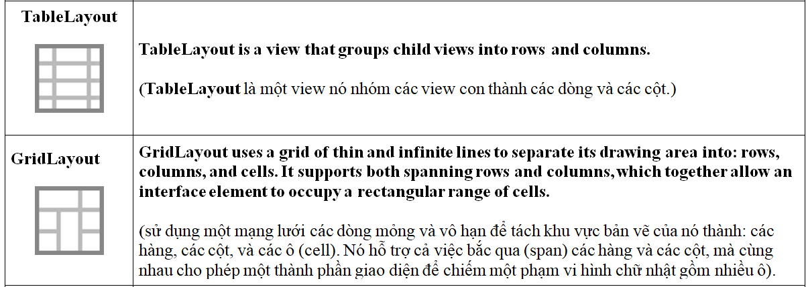
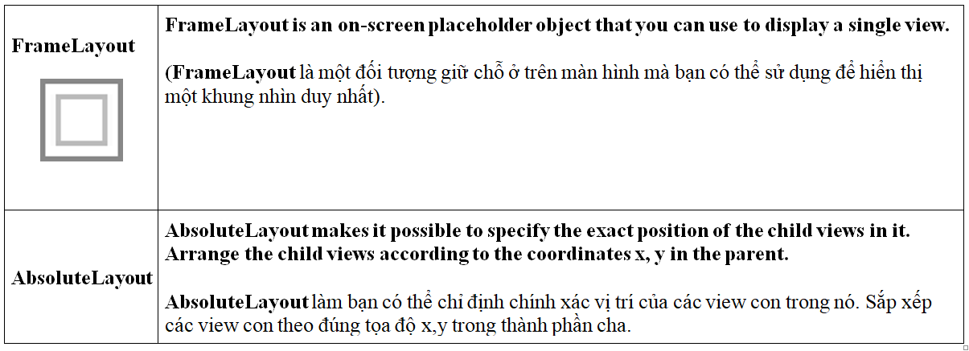
CONCLUTIONS LAYOUT

Slide 26
LAYOUT / VIEW GROUP
OTHER COMPONENT
STYLE
THEMES

Slide 27
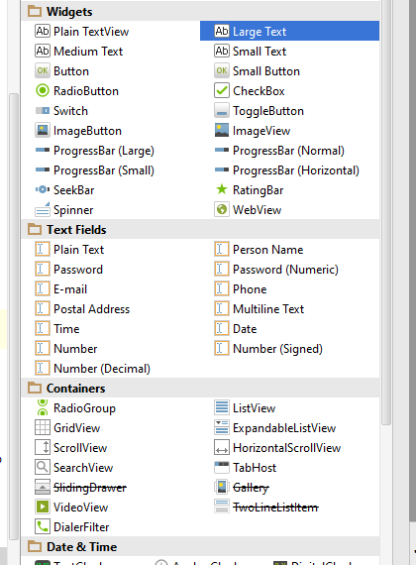
UI COMPONENTS
Text View
EditText
AutoCompleteText
Button
ImageButton
ToggleButton
CheckBox
RadioButton
RadioGroup
ProgressBar
Spinner
DatePicker
TimePicker
AlertDialog
Raitingbar….
https://abhiandroid.com/ui/textview

Slide 28
LAYOUT / VIEW GROUP
OTHER COMPONENT
STYLE
THEMES

Slide 29
STYLE
Styles and themes on Android allow you to separate the details of your app design from the UI structure and behavior (CSS)
A style is a collection of attributes that specify the appearance for a single View
Font color
Font size
Background color
….

Slide 30
THEME
A theme is a type of style that's applied to an entire app, activity, or view hierarchy, not just an individual view.
When you apply your style as a theme, every view in the app or activity applies each style attribute that it supports.
Themes can also apply styles to non-view elements, such as the status bar and window background.
Styles and themes are declared in a style resource file in res/values/, usually named styles.xml.

Slide 31
QUESTION
&
THANK YOU FOR YOUR ATTENTION

